Slide 1

INDIAN INSTITUTE OF INFORMATION TECHNOLOGY, SONEPAT
PROJECT-1 (CSL-507)
(2020-24)
Submitted to: Dr. Mukesh Mann, Mr. Rohit Pratap

Slide 2
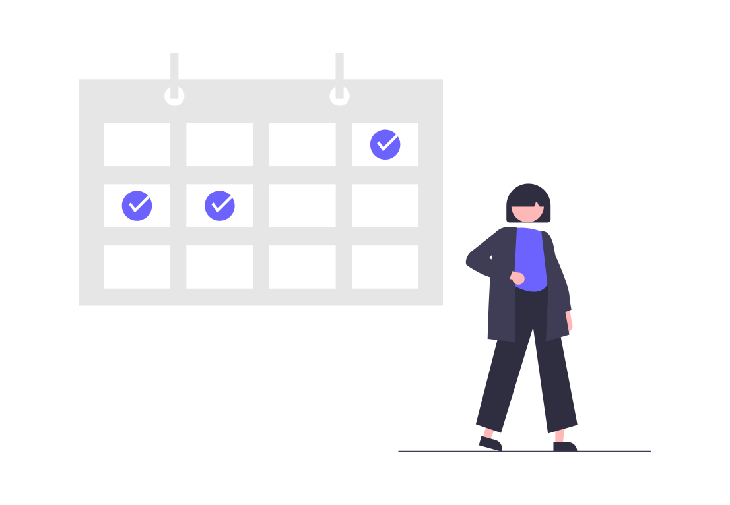
Health Management and
Appointment webapp
Branch: Computer Science and Engineering (CSE)
Member Details:-
Name Roll No.
Gunjan Ashok Bhanarkar 12011014
Surya Singh Dosanjh 12011038
Hriday Sharma 12011014

Slide 3

About the project
Project Name:- Health Management and Appointment webapp
Type:- Full stack web application
Objective
Health Management and Appointment web app aims to save the user's time as it is an application to book appointments in hospitals, monitor the calories intake of the users. Major objectives of our project:-
Book/Cancel an appointment for the medical treatment/check-up.
Sets a Medical schedule of medications.
3. Search Diseases by entering any body part.
Calorie Tracker.
Provide exclusive dashboard and user section along with proper authentication.

Slide 4






Tools and software used
HTML, CSS and Javascript language
Vs Code editor
Node.js and Express.js
MongoDB
Git/ Github

Slide 5
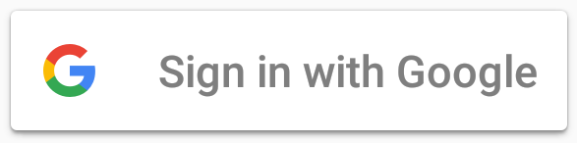
Project contents
User login/ registration: The user will be able to sign up/ log in the web app using google account. Passport strategy for Google OAuth2.0 is used to provide google authentication. Once the user is logged in, he/she will be redirected to the dashboard section showing his/her details and navigation menu to explore the web app.

Slide 6
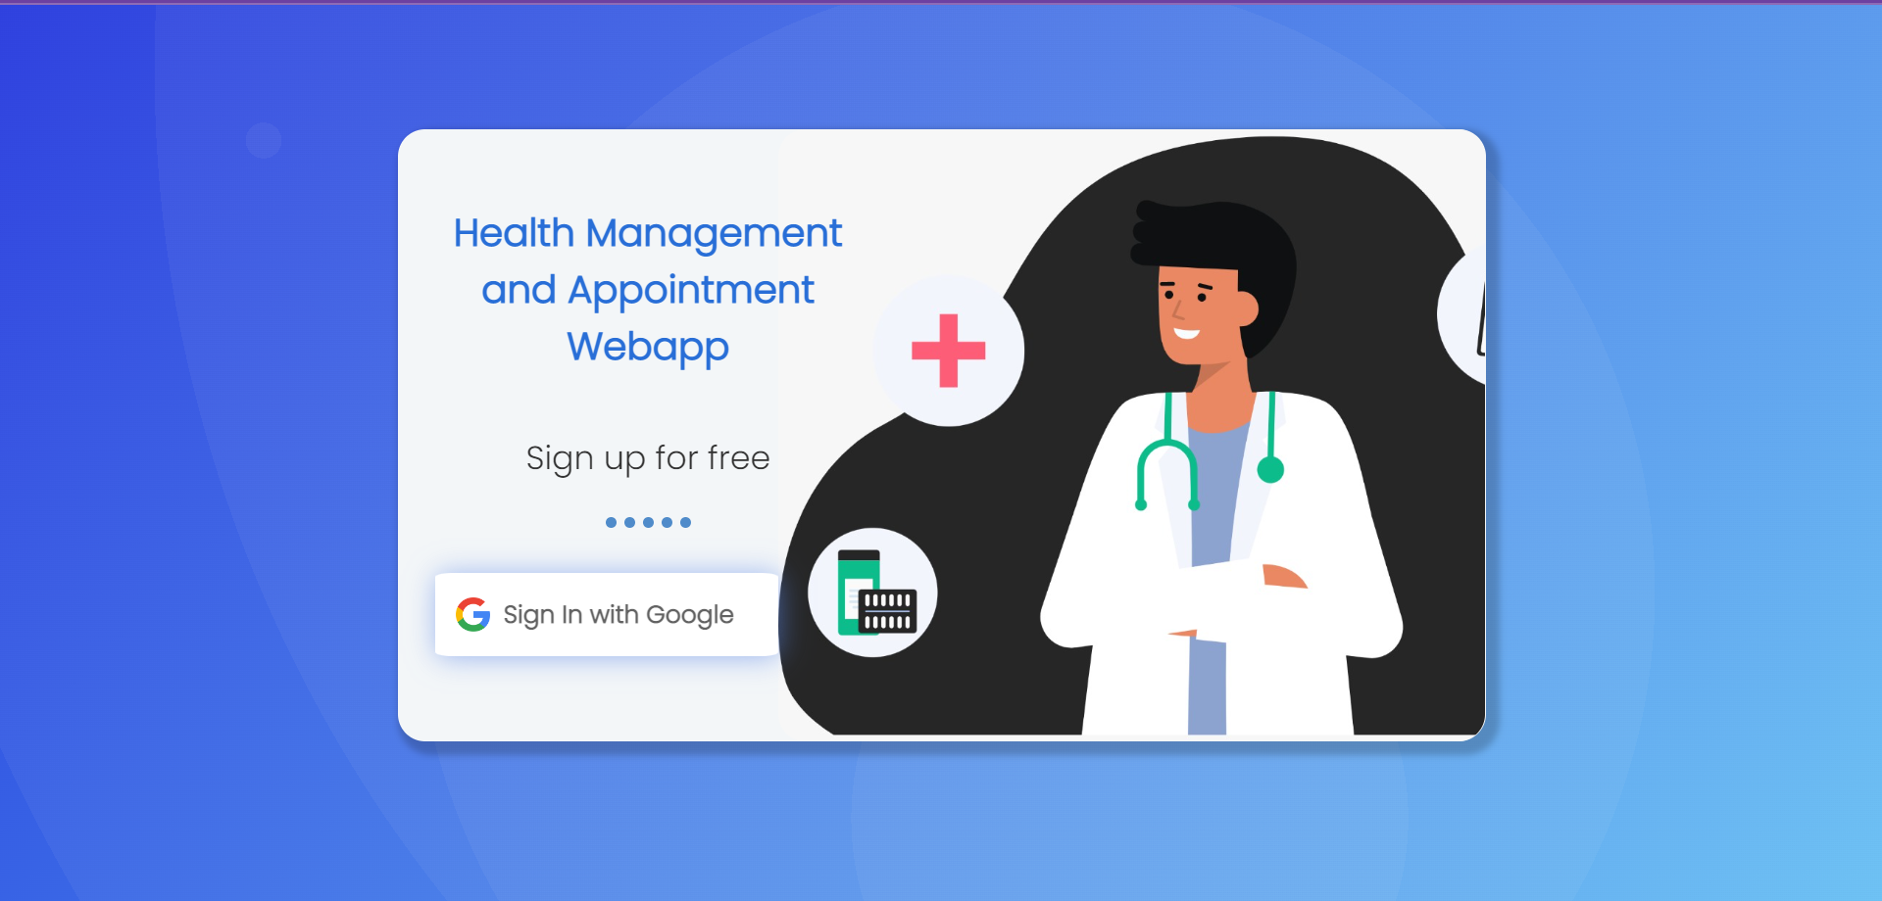
Screenshot of Login page

Slide 7
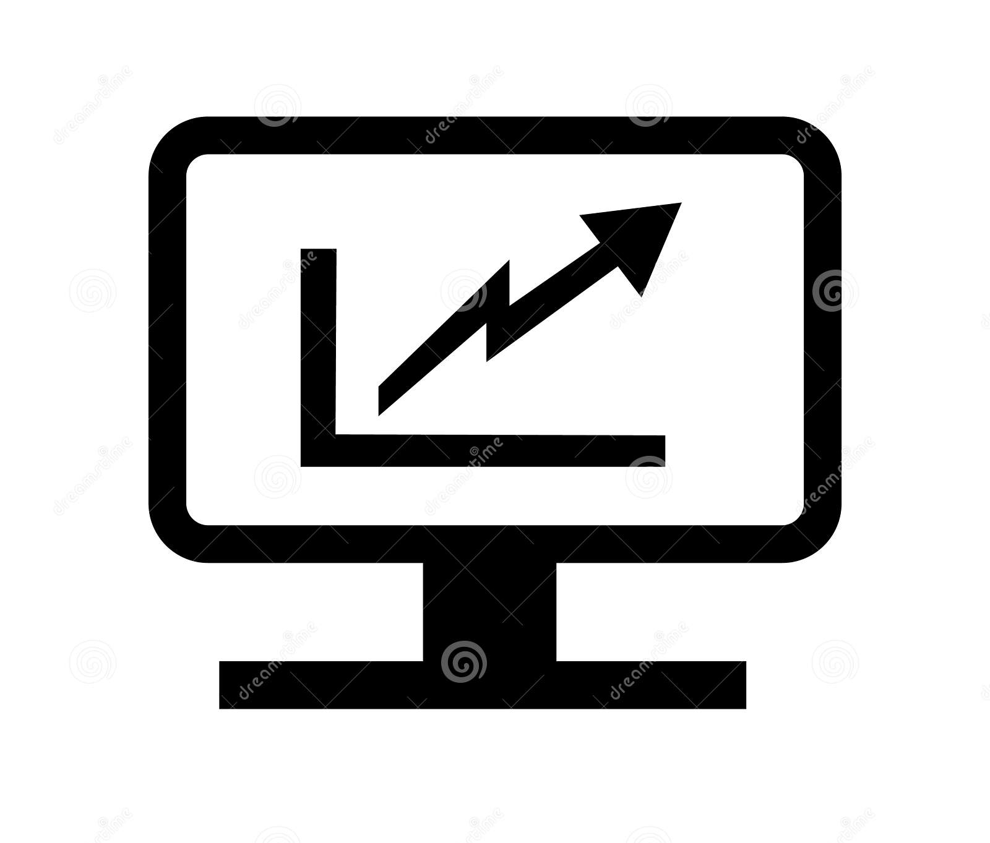
Project contents
2. Dashboard Section: Once the user is successfully registered, he/she is redirected to the dashboard.
On the dashboard, user will see his profile details, as well as other functionality like his/ her medication list, appointments, calendar.
The user can add/ update/ delete his/her
Medicine list in the dashboard.

Slide 8
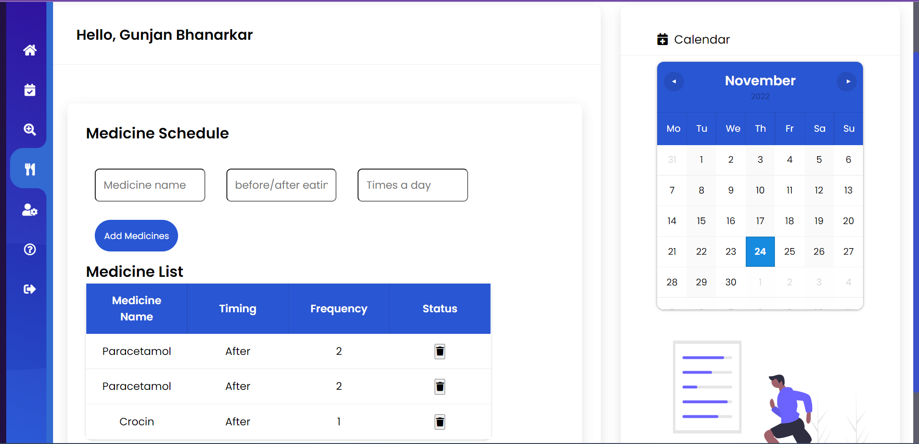
Screenshot of User Dashboard

Slide 9

Project contents
3. User Profile Section: The user will be add/ update/ delete his/her personal information/ data in the profile section. Some data like name, email id etc. will be fetched directly from the linked google account. The same data can be updated/changes along with additional data like gender, age, blood group, height weight etc. will be required to be filled by the user.
Once the user is successfully registered, he/she will be redirected to the dashboard.

Slide 10
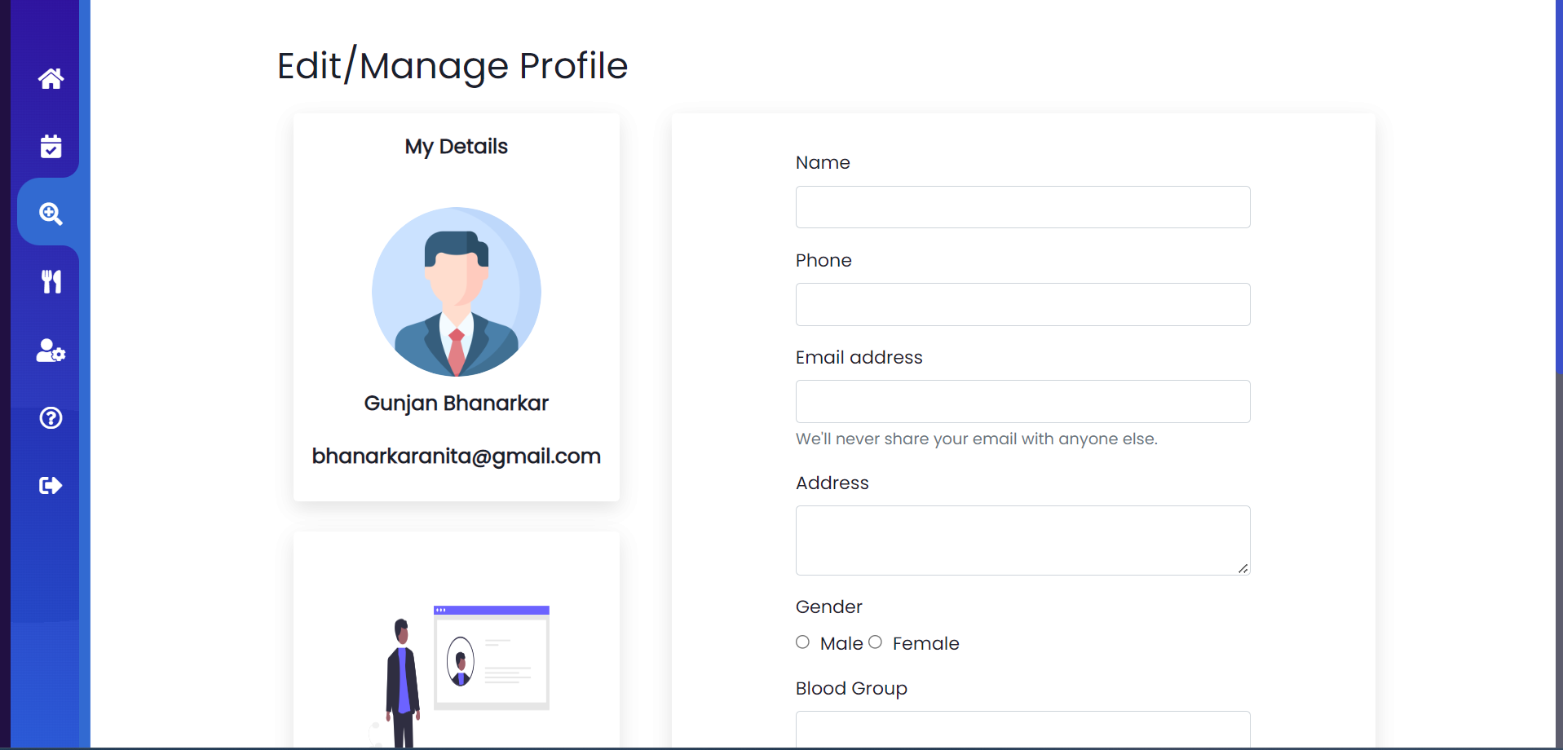
Screenshot of Profile Section

Slide 11
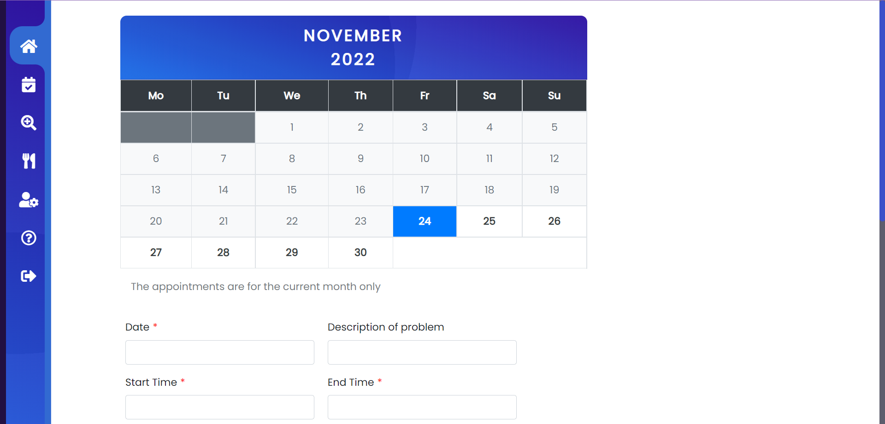

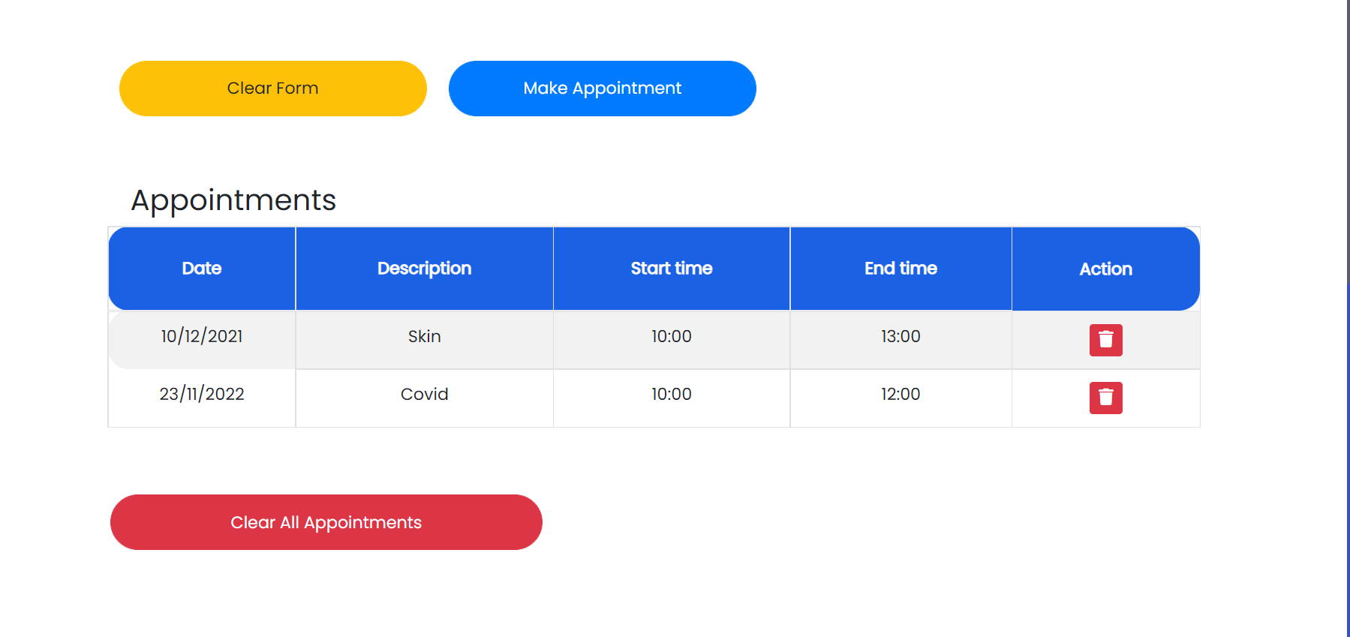

Project Contents
3. Appointment Booking Interface:
The user will be able to book
Appointments on particular date and
time with nearby hospitals, the
appointment data will be stored in the
database.

Slide 12
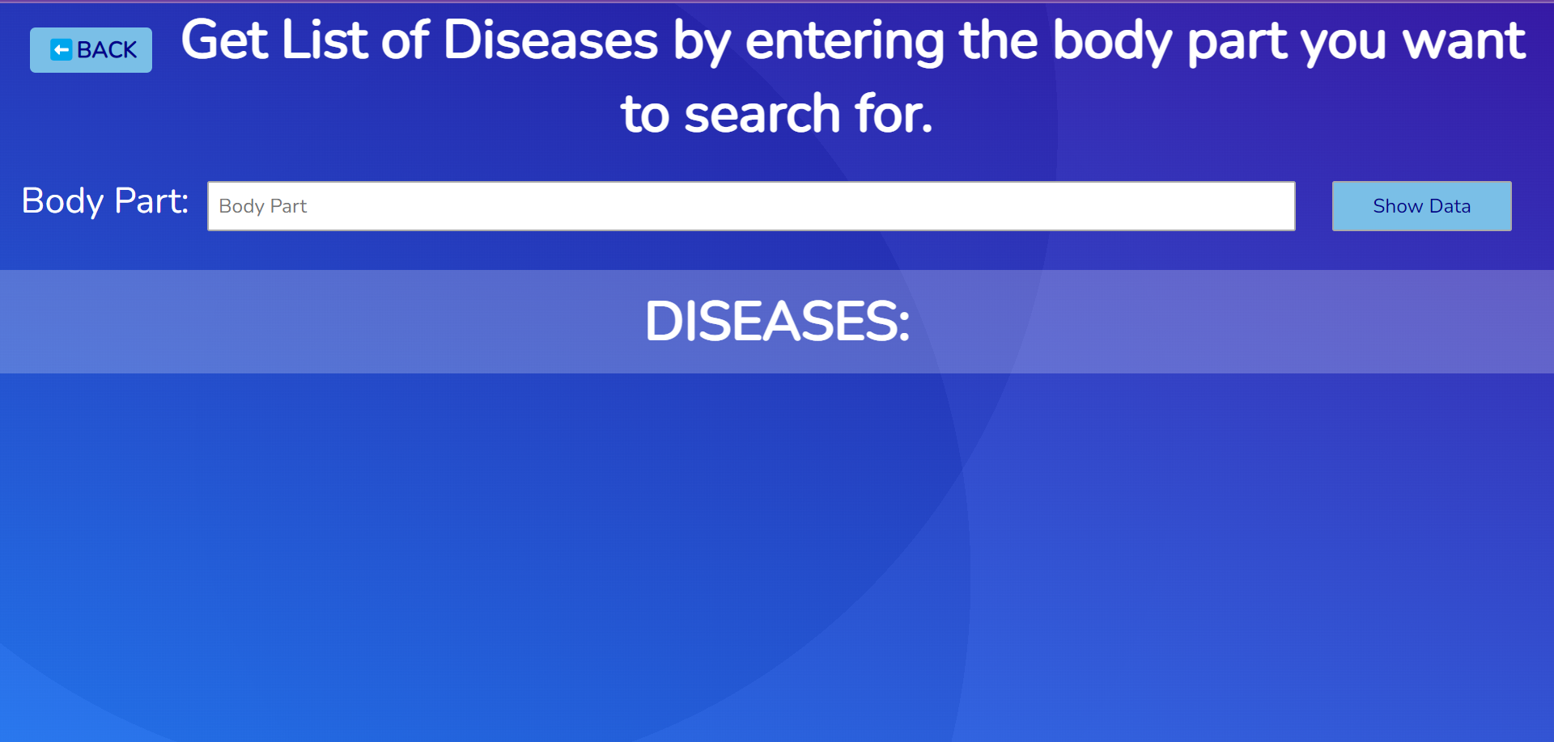
Project contents
4. Search Diseases: In this section, user can enter any particular body part he/she has any issue with i.e pain, or any unknown symptoms.
Then the user will get a list of diseases related to that body part.

Slide 13
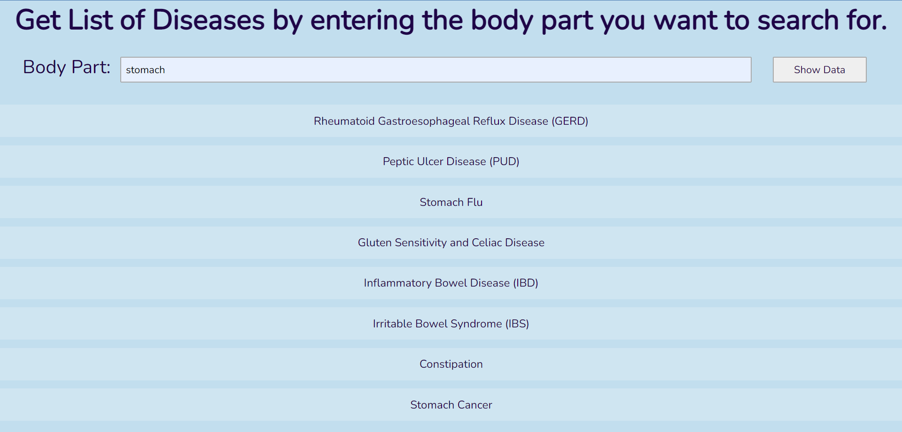
Screenshot of Disease search:

Slide 14
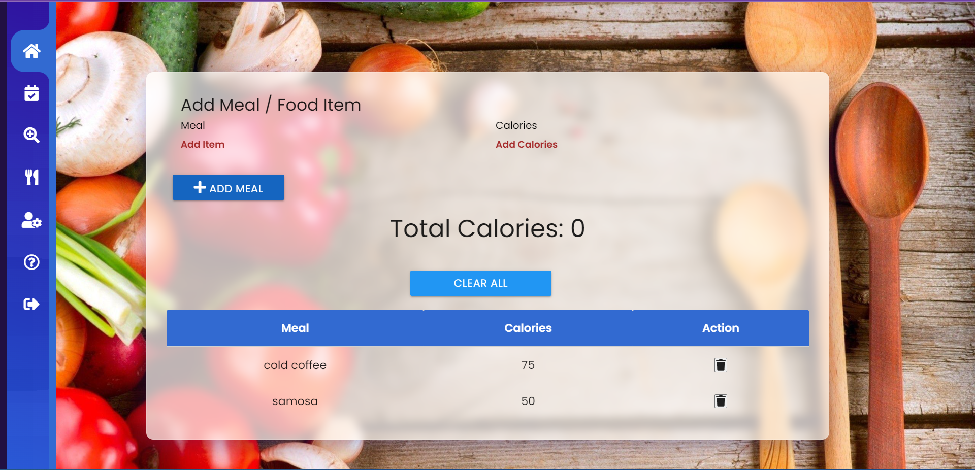

Project Contents
5. Calorie Tracker: There is a food/ calorie tracker, in which user will keep data of the food he/she has consumed and the total calorie gain/loss will be displayed accordingly, all data is stored in database.

Slide 15


